Slide 1
Evolutionary Computation
Miguel León Ortiz
Mälardalen University

Slide 2
Evolutionary Computation
Evolutionary computation (EC) simulates natural selection in a computer program to improve system performance automatically
Like natural selection, EC aims to facilitate stochastic search in problem space
EC conducts randomized, parallel beam search (population-based algorithms). It becomes more popular with advancement of computer hardware.

Slide 3
Family of Evolutionary Computation
Evolutionary Algorithms
Genetic algorithms
Genetic programming
Differential Evolution
....
Swarm Intelligence
Ant Colony Optimization
Particle Swarm Optimization
Artificial Bee colony
Memetic algorithm
....

Slide 4
AGENDA
Evolutionary Algorithms
Genetic algorithm
What is it?
Types
Important parts
Differential Evolution
Genetic Programing
Swarm Intelligence
Particle Swarm Optimization (PSO)
Basics
Movements of particles
Topologies
Ant Colony Optimization (ACO)
Basics
Artificial Ant

Slide 5
Evolutionary Algorithms

Slide 6
Evolutionary Algorithms
Evolutionary Algorithms (EA) implement mechanism inspired by biological evolution such as:
Repreduction
Mutation
Recombination
Natural Selection
Candidates solutions play an important role inside the population.
The cost function will determine which solution ”Live”

Slide 7
Family of Evolutionary Algorithms
Genetic Algorithm (GA)
Genetic Programming (GP)
Evolutionary Programming (EP)
Evolutionary Strategy (ES)
Differential Evolution (DE)
........

Slide 8
Genetic Algorithm

Slide 9
What is a Genetic Algorithm (GA)?
The genetic algorithms
are a class of algorithms for optimization, search and learning, which are inspired by
Natural Evolution
and
Genetic Evolution

Slide 10
Flow Chart of Traditional Genetic Algorithm
Create initial random population
Evaluate fitness of each individual
Yes
Stop and return
the best one in the population
Termination criteria satisfied ?
No
Select parents according to fitness
Recombine parents to generate a set of offspring
Mutate offspring
Replace population by the set of new offspring

Slide 11
Two models: Gerenational and stationary
Generational model: A completely new population of new individuals is created in every iteration.
The new population replace the old one.
Stationary model: Two parents are chosen and the genetic operators (crossover and mutation) are applied to produce offspring. Only the best individuals from the parents and offspring survive in the next generation.

Slide 12
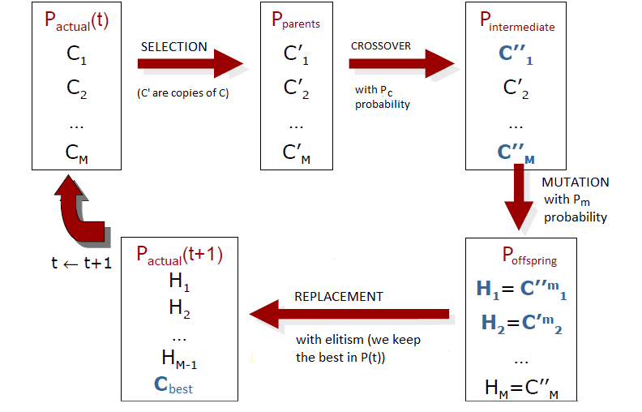
Generational model

Slide 13
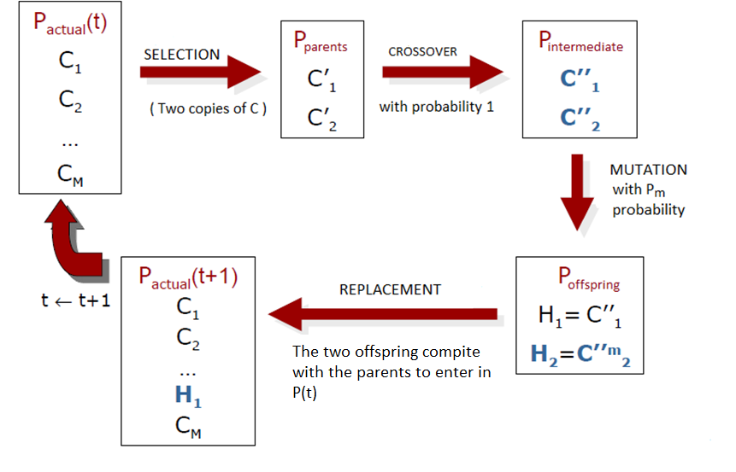
Stationary model

Slide 14
How to build a genetic algorithm?
Design a representation
Decide how to initialize a population
Design a way to evaluate an individual (fitness function)
Decide how to select the parents
Design a crossover operator
Design a mutation operator
Decide how to replace the individuals
Decide when to stop

Slide 15


Representation
There are several kinds of representation. The two more common are:
Binary representation:
Real representation:

Slide 16
Intizialize
Two ways:
Randomly created in the search space:
Binary representation: 0 or 1 with probability 0.5
Real representation: Uniform inside the range.
Choose the initial population to contain solution(s) from a previous search.

Slide 17
Selection strategy
Tournament Selection (TS): Choose the best from the k randomly selected individuals from the population. K is the size of the tournament.
Linear Order(LS): The population is ordered according the fitness value and then a probability is given according to the order.
(NAM): The first parent is chosen randomly. The other is chosen according to the distance with the first one. So the most different individual will be chosen.
Roulette Selection: A probability is assigned to an individual, proportional to the fitness of this individual.

Slide 18
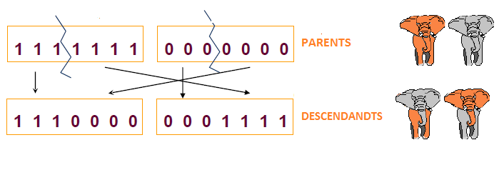
Crossover (1)
Crossover operator with binary representation (example 1):

Slide 19
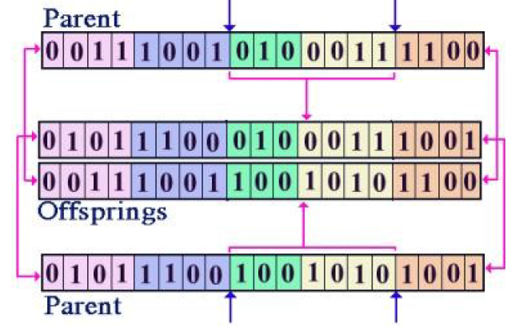
Crossover (2)
Crossover operator with binary representation (example 2):

Slide 20
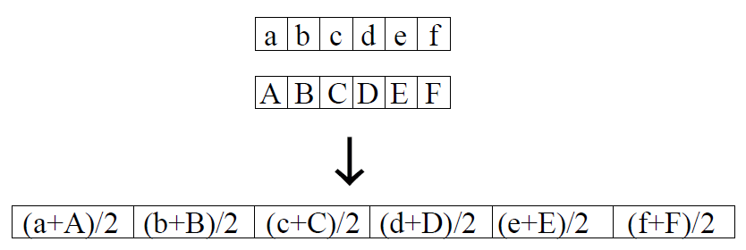
Crossover (3)
Crossover operator with a real representation (Example 1).
Arithmetic Recombination.

Slide 21

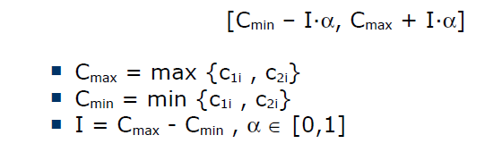
Crossover (4)
Crossover operator with a real representation (Example 2).
BLX-α.
Given 2 individuals
BLX- α creates two descendants
where hki is created randomly in the interval:

Slide 22
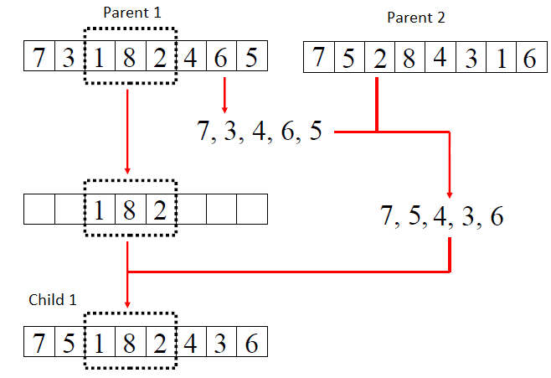
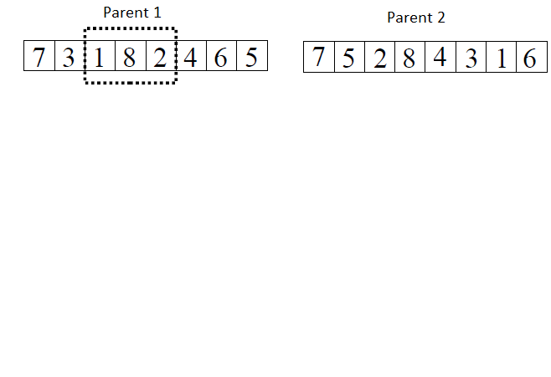
Crossover (5)
Crossover operator with a order representation (Example 1).

Slide 23
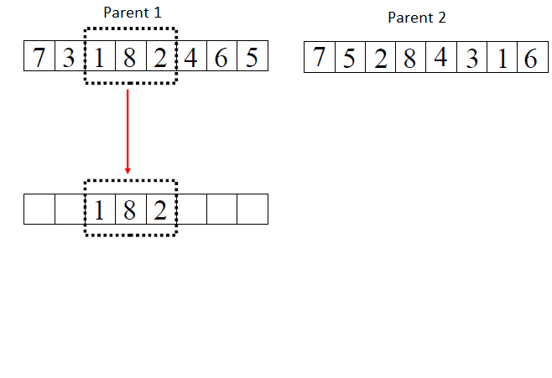
Crossover (5)
Crossover operator with a order representation (Example 1).

Slide 24
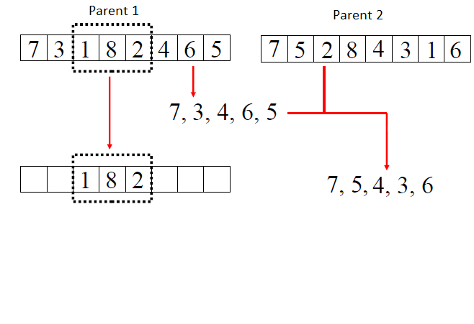
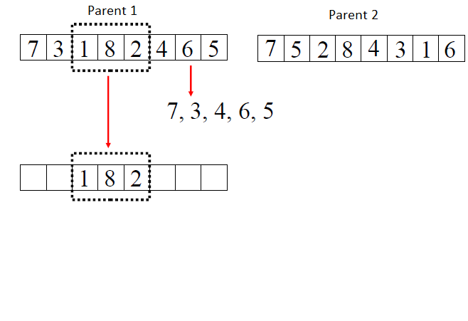
Crossover (5)
Crossover operator with a order representation (Example 1).

Slide 25
Crossover (5)
Crossover operator with a order representation (Example 1).

Slide 26
Crossover (5)
Crossover operator with a order representation (Example 1).

Slide 27
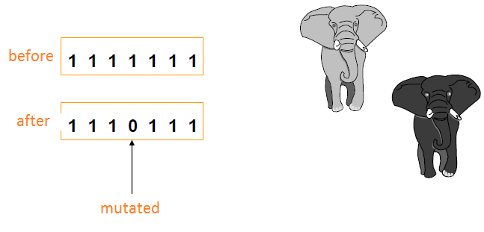
Mutation (binary representation)
Mutation operator with binary representation:

Slide 28
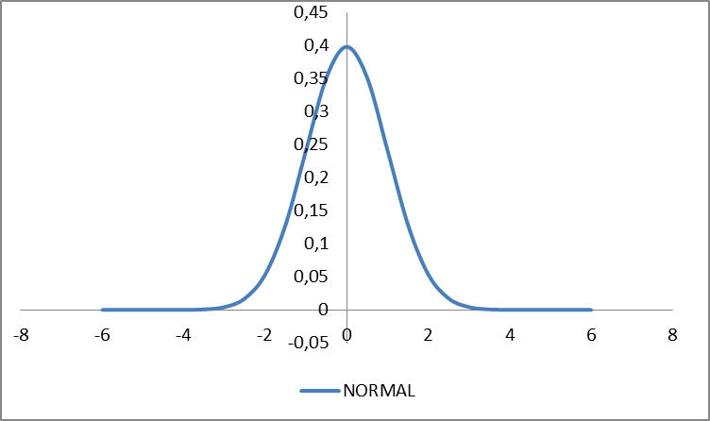
Mutation (real representation)
● Given an offspring string X=[x₁, x₂, …., x_{n}], mutation can be done by adding to each number in the string a random disturbance u_{i}, which is subject to a normal density function N(0, δ).
● Consequently, we will have mutated offspring as:
X’=[x’₁, x₂, …., x’_{n}]
with x’_{i}=x_{i}+u_{i}
● For example, in matlab we have the function sqrt(δ) * randn(1).

Slide 29
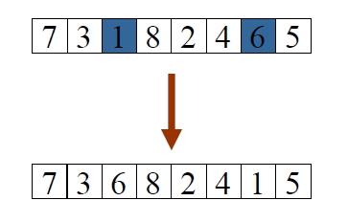
Mutation (order representation)
Select two random positions and change the elements.

Slide 30
Replacement (generational model)
The offspring replace the entire population.
We can decide to keep the best individual: ELITISM
(It is recommended to use elitism)
It is possible to have high grade of elitism, keeping N best individuals in the population.

Slide 31
Replacement (stationary model)
Replace the worst in the population (RW).
Restricted tournament (RTS): The offspring replaces the most similar individual among w (w=3,4,…) individuals previously selected.
Worst between similar (WAMS): We select a group of individuals most similar to the offspring individual. The offspring replaces the worst individual in the group.

Slide 32
Stop criterion
If we find the optimum!!
Maximum number of evaluations.
Maximum number of iterations (generations)
Limit of the user:
Time
After some iterations without improvement

Slide 33
Differential Evolution

Slide 34
Differential Evolution - Definition
Differential Evolution (DE) is a population-based evolutionary algorithm.
New solutions (individuals) are created based on differences between pair(s) of individuals randomly selected from the population.
DE has been popular in many applications due to its high ability, simple implementation and easy use.

Slide 35
Differential Evolution – Flow chart
Create initial random population
Evaluate fitness of each individual
Yes
Stop and return
the best one in the population
Termination criteria satisfied ?
No
Mutate the population to obtain mutated population
Recombine each mutated individual with its parent to get offspring
Actualize population with the set of new offspring

Slide 36
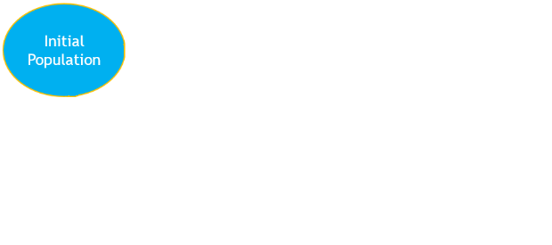
Differential Evolution

Slide 37
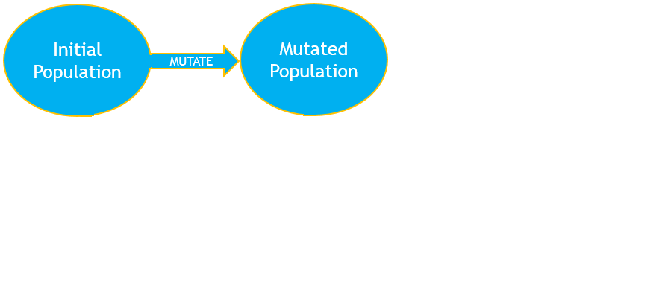
Differential Evolution

Slide 38
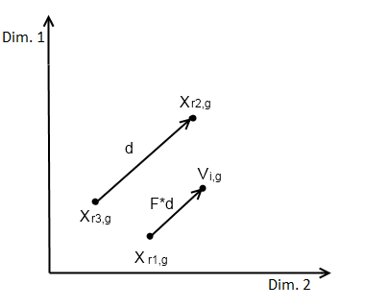
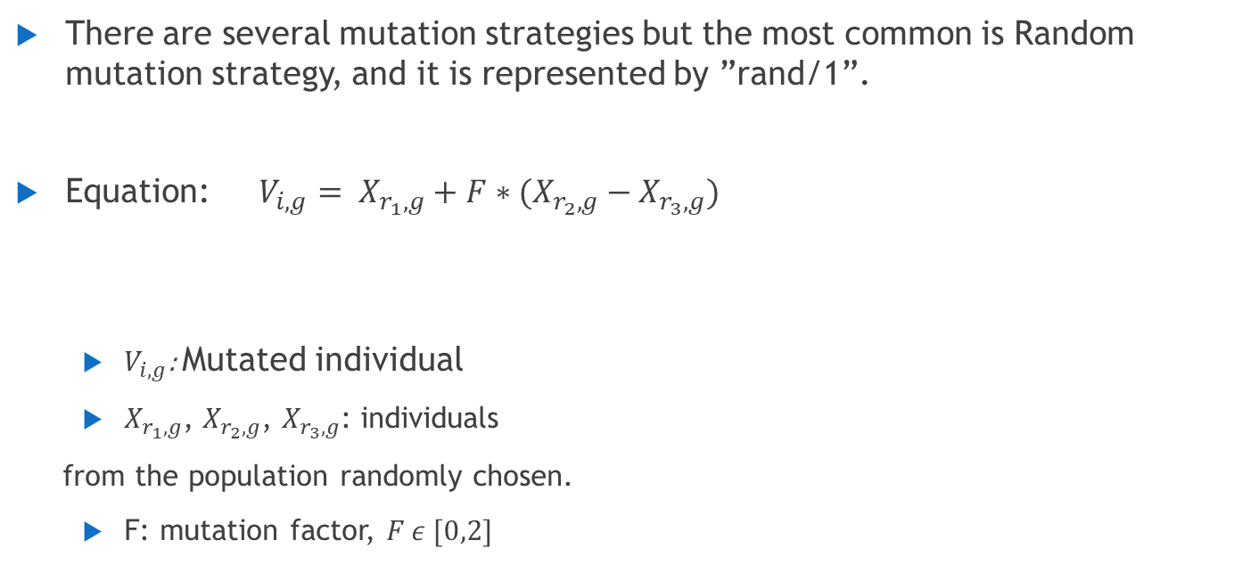
Differential Evolution - Mutation
There are several mutation strategies but the most common is Random mutation strategy, and it is represented by ”rand/1”.
Equation: $V_{i,g}= X_{r_{1},g}+F∗(X_{r_{2},g}−X_{r_{3},g})$
$V_{i,g}$: Mutated individual
$X_{r_{1},g}$, $X_{r_{2},g}$, $X_{r_{3},g}$: individuals
from the population randomly chosen.
F: mutation factor, $F ε [0,2]$

Slide 39
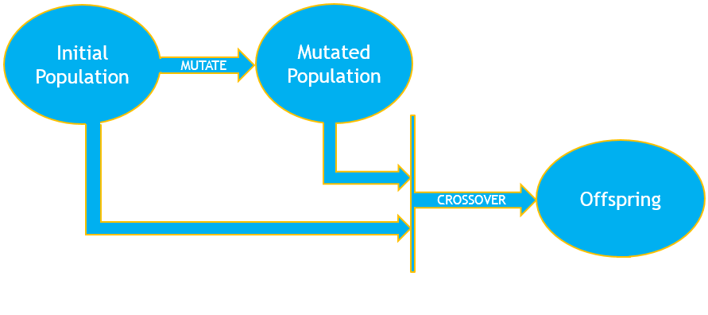
Differential Evolution

Slide 40
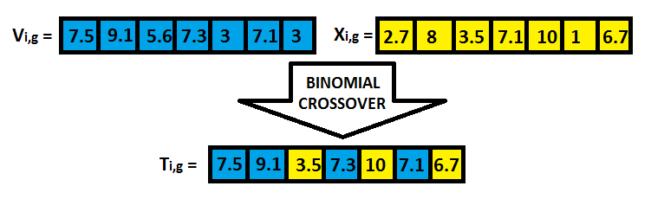
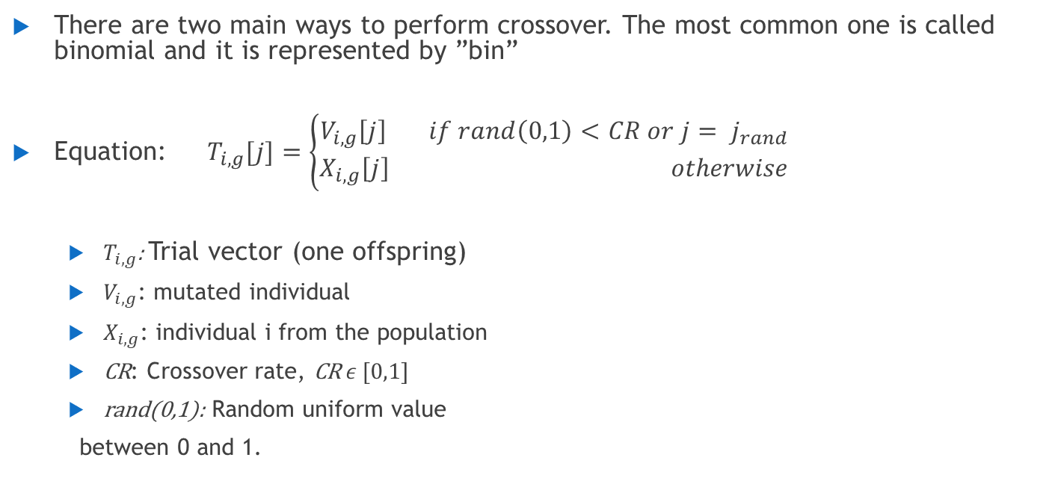
Differential Evolution - Crossover
There are two main ways to perform crossover. The most common one is called binomial and it is represented by ”bin”
Equation: $T_{i,g}[j]=\left\{\begin{aligned}V_{i,g}\left[j\right] if rand\left(0,1\right)<CR or j= j_{rand} \\ X_{i,g}\left[j\right] otherwise\end{aligned}\right.$
$T_{i,g}$: Trial vector (one offspring)
$V_{i,g}$: mutated individual
$X_{i,g}$: individual i from the population
CR: Crossover rate, CR$ε [0,1]$
rand(0,1): Random uniform value
between 0 and 1.

Slide 41
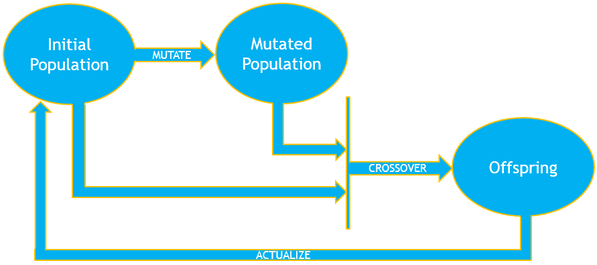
Differential Evolution

Slide 42
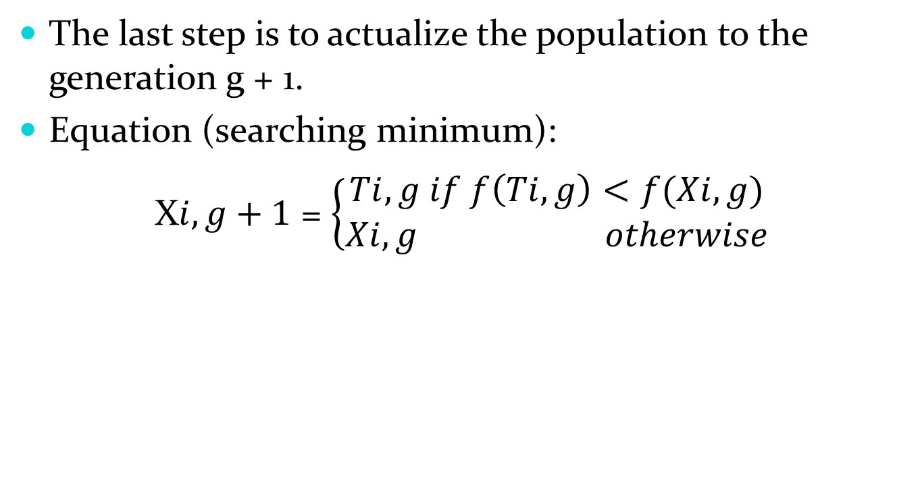
DE - Selection
Ti,g: Trial vector (one offspring)
Xi,g: Individual i from the population
Xi,g+1: Individual i in the population for the next generation
f(vector): fitness of the vector

Slide 43
Differential Evolution

Slide 44
Genetic Programming
Miguel Leon

Slide 45
Genetic Programming
Automatic generation of computer programs by means of natural evolution
Individuals in population are programs represented as trees
Tree nodes correspond to functions :
- arithmetic functions {+,-,*,/}
- logarithmic functions {sin,exp}
Leaf nodes correspond to terminals :
- input variables {X₁, X₂, X₃}
- constants {0.1, 0.2, 0.5 }
+
X₁
*
X₁+(X₂*X₃)
X₂
X₃

Slide 46
Genetic Programming : Crossover
Crossover is performed by exchanging randomly chosen parts
between parents
+
-
parent A
parent B
X₁
*
X₂
/
X₂
X₃
-
X₁
-
X₂
X₃
*
/
+
offspring A
X₂
X₃
-
X₁
offspring B
X₁
X₂
X₂
X₃

Slide 47
Genetic Programming: Mutation
A mutation operator can randomly change any function or any terminal in the tree.
-
+
X₂
/
X₁
*
-
X₁
-
X₂
X₃
X₂
X₃
X₄
/
+
X₁
+
-
X₁
X₂
X₃
X₂
X₃

Slide 48
SWARM INTELLIGENCE

Slide 49
Swarm Intelligence
Swarm intelligence (SI) simulates biological systems, as ant colonies or birds flocking.
SI are composed by simple agents (also called boids) that will interact locally between each other.

Slide 50
Family of Swarm Intelligence
Particle Swarm Optimization (PSO)
Ant Colony Optimization (ACO)
Artificial Bee Colony (ABC)
Firefly Algorithm (FA)
Cuckoo Search (CS)
...

Slide 51
Particle Swarm Optimization

Slide 52
Particle Swarm Optimization (PSO)
Particle Swarm Optimization is a population-based algorithm inspired by the social flight of the birds and the movement of the fishes.
PSO was created in 1995 by Russ C. Eberhart and James Kennedy.
PSO is used in continuous optimization.

Slide 53
Basics
PSO simulate the behavior of the flock of birds.
Imagine that one of this flock is searching food in an area and there is only one peace of food in that area.
The birds does not know were the food is, but they know the distance to it.
The most efficient strategy will be to follow the bird that is closer to the food.

Slide 54
Basics (2)
The population will be a multi-agent system where every bird or particle will be an agent.
Every particle will have a fitness (in this case distance to the food), a position in the space and a velocity vector (the direction that the particle is tacking)

Slide 55
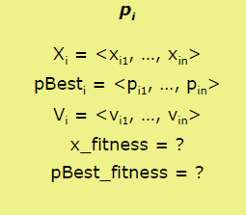
Anatomy of a particle
A particle is composed by:
Three vectors:
Vector X, with the actual location of the particle.
Vector pBest, with the location of the best position found by the particle.
Vector V, with the gradient (direction, velocity) that the particle will move,
Two fitness’s values:
x_fitness, with the fitness of the actual solution (X).
pBest_fitness, with the fitness of the best solution
found by the particle

Slide 56
Initialization of the particles
The position of the particle is generated randomly in the search space.
The velocities are randomly generated, with every component in the interval [-Vmax, Vmax]
Do not initializate them to 0, it does not give good results.
Vmax is the maximum movement that the particle will take in every generation.

Slide 57
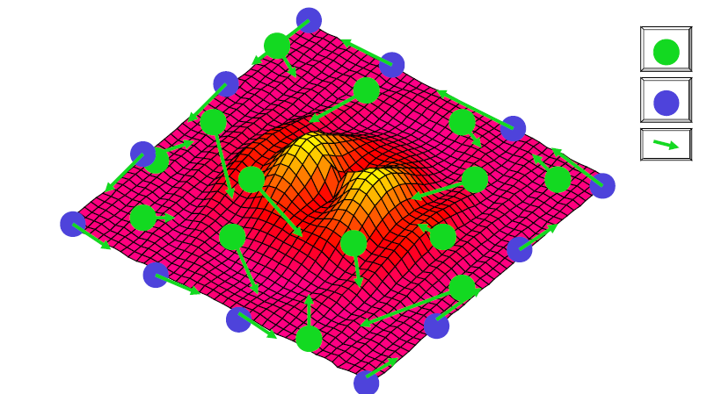
Initialization of the particles (2)

Slide 58

Movement of the particles
The Velocity (V) will be added to the position (X), to get the new vector position:
After calculating the new position of the particle, we need to evaluate it. If the new fitness is better than the one that the particle had, pBest_fitness, then:

Slide 59


Movement of the particles (2)
The first step is to adjust the velocity vector, and then add it to the position vector.
The equations are:
Xi is the particle, pBest is the best solution found by the particle.
j1,j2 are learning ratios (weight) to control the cognitive and social component.
g represents the index of the particle with the best pBest_fitness of the neighbour (lBest) or the global best (gBest),
Rnd() are numbers randomly generated in the interval [0,1], and d is the dimension d of the vector.

Slide 60



Movement of the particles (3)
Types of PSO algorithms
Kennedy identify four types of PSO algorithms depending of
Complete Model:
Only Cognitive:
Only Social:
Only Social Exclusive: Also g is different than x

Slide 61
Topology of the particle population
The topologies define the neighbor of every individual. The particle will always belong to its neighbor.
There are two types of topologies:
Geographical: The distances between the actual particle and the rest are calculated and the neighbor of the particle will be composed by the closer ones.
Social: The neighbor of a particle is predefined, no matter the position.
The social topology are more used.

Slide 62
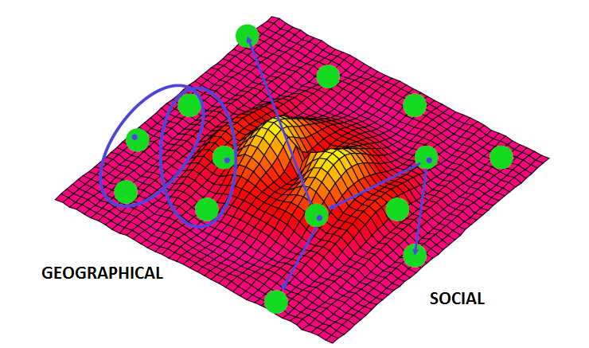
Topology of the particle population (2)

Slide 63
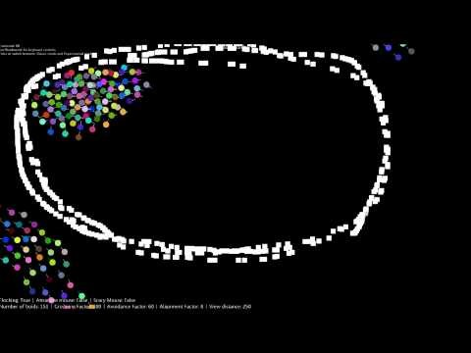
Multiple robot searching

Slide 64
Ant Colony Optimization

Slide 65
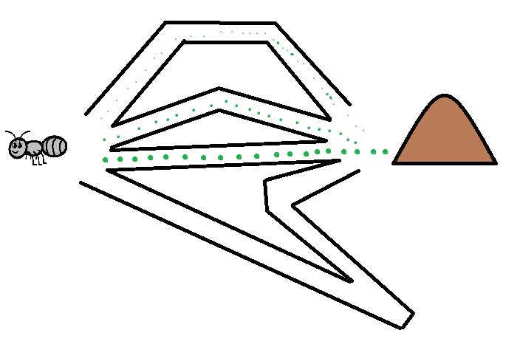
Ant Colony Optimization (ACO)
Ant Colony System was invented by Marco Dorigo in 1992
This algorithm is based on the behavior of real ants
It is used to find the shortest path in a graph

Slide 66
Ant Colony Optimization (ACO): Basics
The ants are BLIND (not all of them).
The ants are attracted by pheromones in neighbor nodes.
Once an ant leave the nest start leaving pheromone on the way it walked.
When they find the food, they come back, placing pheromone again.
The next time they leave the nest they will take the path with more pheromone.

Slide 67
Ant Colony Optimization (ACO): example

Slide 68
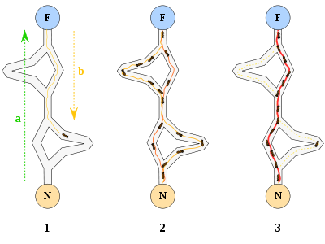
Ant Colony Optimization (ACO): example

Slide 69
Ant Colony Opimization (ACO): Natural ants example

Slide 70
Ant Colony Opimization (ACO): Natural ants example

Slide 71
Ant Colony Opimization (ACO): Natural ants example

Slide 72
Ant Colony Opimization (ACO): Natural ants example

Slide 73
Ant Colony Opimization (ACO): Natural ants example

Slide 74
Ant Colony Opimization (ACO): Natural ants example

Slide 75
Ant Colony Optimization (ACO)
The ACO algorithms imitate the real ants in an artificial ant colony to solve problems of the minimum path.
Each artificial ant is a probabilistic mechanism to build solutions to the problem (an agent that imitate a real ant). It uses:
Pheromone, τ (tau), that change through the time to reflect the experience of the agents.
Heuristic information, η (eta), about the problem being solved.

Slide 76
Artificial ant
The artificial ant is an agent that:
It remembers all the travelled nodes, using a list of visited nodes (L). At the end, this list will contain a solution built by the ant.
In every step, the ant will move from city r to the city s (s is a city that it was not visited before by this ant). It will use a probabilistic transition rule.

Slide 77
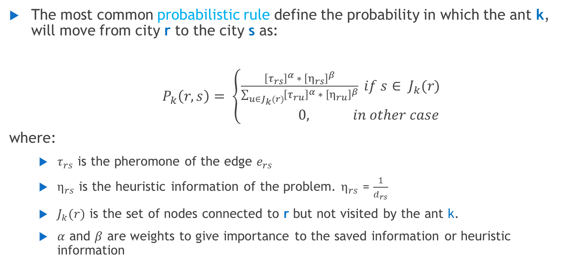
Artificial Ant: Probabilistic rule
The most common probabilistic rule define the probability in which the ant k, will move from city r to the city s as:
$P_{k}\left(r,s\right)= \left\{\begin{aligned}\frac{{\left[τ_{rs}\right]}^{α} ∗ {\left[η_{rs}\right]}^{β}}{\sum_{u∈J_{k}(r)}{{\left[τ_{ru}\right]}^{α} ∗ {\left[η_{ru}\right]}^{β}}} if s∈ J_{k}(r) \\ 0, in other case\end{aligned}\right.$
where:
$τ_{rs}$ is the pheromone of the edge $e_{rs}$
$η_{rs}$ is the heuristic information of the problem. $η_{rs}$ = $\frac{1}{d_{rs}}$
$J_{k}(r)$ is the set of nodes connected to r but not visited by the ant k.
$α$ and $β$ are weights to give importance to the saved information or heuristic information

Slide 78
Artificial Ant: update the pheromone
Positive feedback is used to strengthen the future components of the good solutions.
If the solution is better, more pheromone will be added.
Evaporation of the pheromone is used to avoid an infinite increment of the pheromone and there is a possibility to forger bad decisions.
The evaporation is the same for all the edges. A percentage of the actual value is eliminated: 0 < p < 1

Slide 79
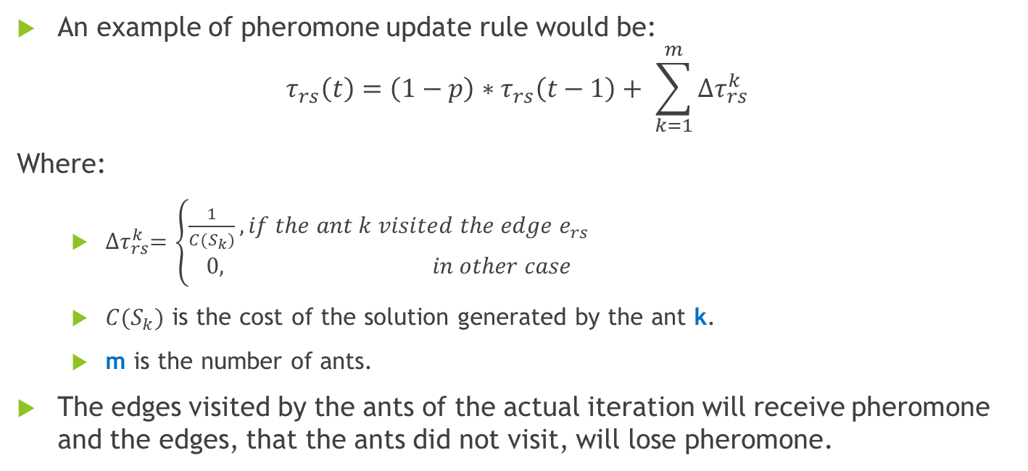
Artificial Ant: update the pheromone (2)
An example of pheromone update rule would be:
$$τ_{rs}\left(t\right)=\left(1−p\right)∗τ_{rs}\left(t−1\right)+ \sum_{k=1}^{m}{{∆τ}_{rs}^{k}}$$
Where:
${∆τ}_{rs}^{k}=\left\{\begin{aligned}\frac{1}{C(S_{k})}, if the ant k visited the edge e_{rs} \\ 0, in other case\end{aligned}\right.$
$C(S_{k})$ is the cost of the solution generated by the ant k.
m is the number of ants.
The edges visited by the ants of the actual iteration will receive pheromone and the edges, that the ants did not visit, will lose pheromone.

Slide 80
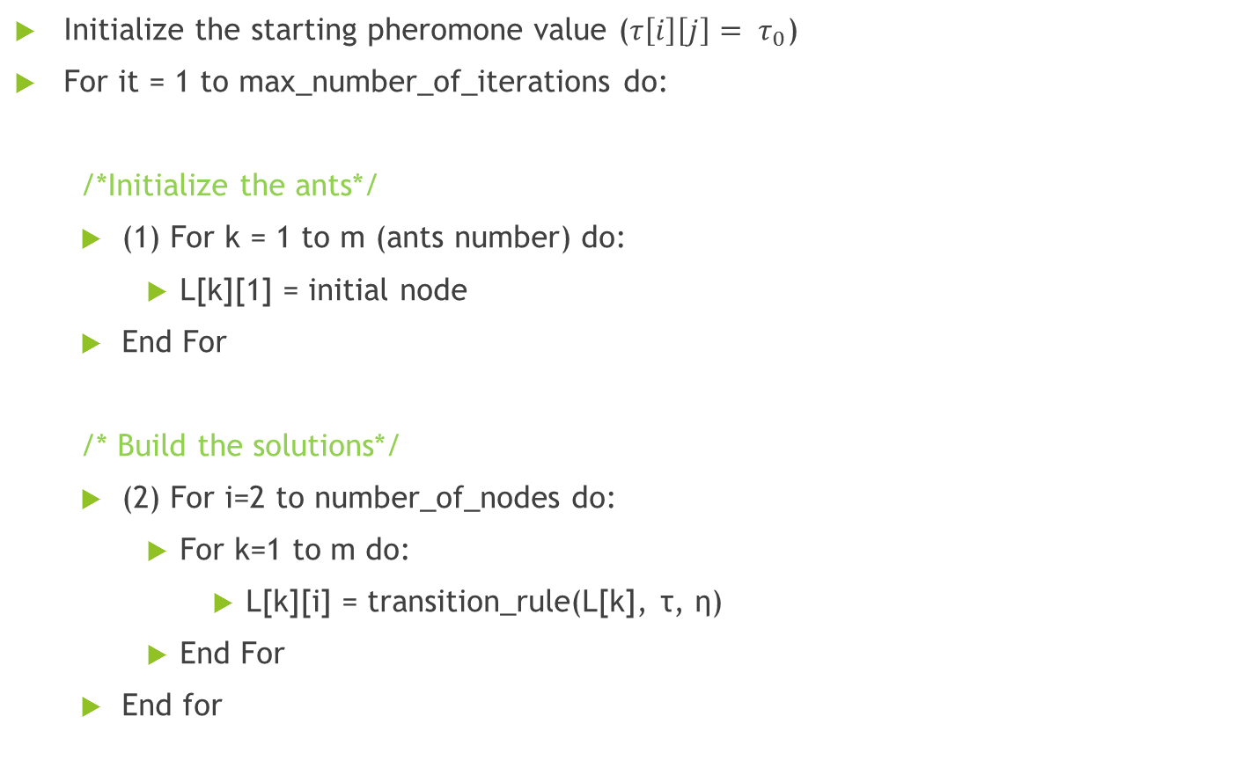
Pseudocode (1)
Initialize the starting pheromone value ($τ\left[i\right]\left[j\right]= τ_{0}$)
For it = 1 to max_number_of_iterations do:
/*Initialize the ants*/
(1) For k = 1 to m (ants number) do:
L[k][1] = initial node
End For
/* Build the solutions*/
(2) For i=2 to number_of_nodes do:
For k=1 to m do:
L[k][i] = transition_rule(L[k], τ, η)
End For
End for

Slide 81
Pseudocode (2)
/*Calculate the total cost of the ants and the best ant*/
(3) For k = 1 to m do:
Cost[k] = C(L[k])
Actual_Best = best(L[k])
End for
/*Update the pheromone*/
(4) For i=1 to number_of_nodes do:
For j = 1 to number of nodes do:
Pheromone_update(τ[i][j],L,Cost)
End for
End for
(5) if C(actual_best) is better than C(global_best) then:
Global_best = actual_best
End if
End for
Return global best

Slide 82
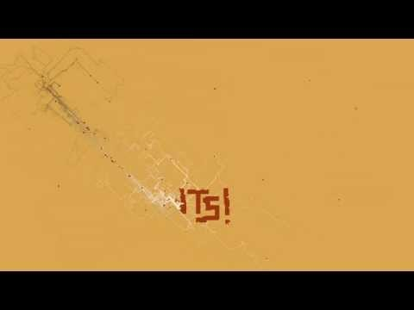

Slide 83
Extra reading (1)
Genetic Algorithms
Norvig, Peter, and Russell, Stuart Jonathan, Artificial intelligence: A modern approach, Pearson Education, 2010 - ISBN: 9780132071482 (Pag. 125 – Pag 129)
Wikipedia page(s): https://en.wikipedia.org/wiki/Genetic_algorithm
Tom M. Holland. Machine Learning. 1997
Differential Evolution
Storn, R., & Price, K. (1997). Differential evolution–a simple and efficient heuristic for global optimization over continuous spaces. Journal of global optimization, 11(4), 341-359.
Improving Differential Evolution with Adaptive and Local Search Methods, Miguel Leon (Link: http://www.diva-portal.org/smash/record.jsf?dswid=-9&pid=diva2%3A1366429&c=1&searchType=SIMPLE&language=en&query=Improving+Differential+Evolution+with+Adaptive+and+Local+Search+Methods&af=%5B%5D&aq=%5B%5B%5D%5D&aq2=%5B%5B%5D%5D&aqe=%5B%5D&noOfRows=50&sortOrder=author_sort_asc&sortOrder2=title_sort_asc&onlyFullText=false&sf=all)

Slide 84
Extra reading (2)
Particle Swarm Optimization
Shi, Y. (2001). Particle swarm optimization: developments, applications and resources. In evolutionary computation, 2001. Proceedings of the 2001 Congress on (Vol. 1, pp. 81-86). IEEE.
Ant Colony Optimization
M. Dorigo, V. Maniezzo, A. Colorni. Ant system: Optimization by a colony of cooperating agents. IEEE Transactions on Systems, Man and cybernetics, Part B, Vol 26, 29-41

